Slide 1

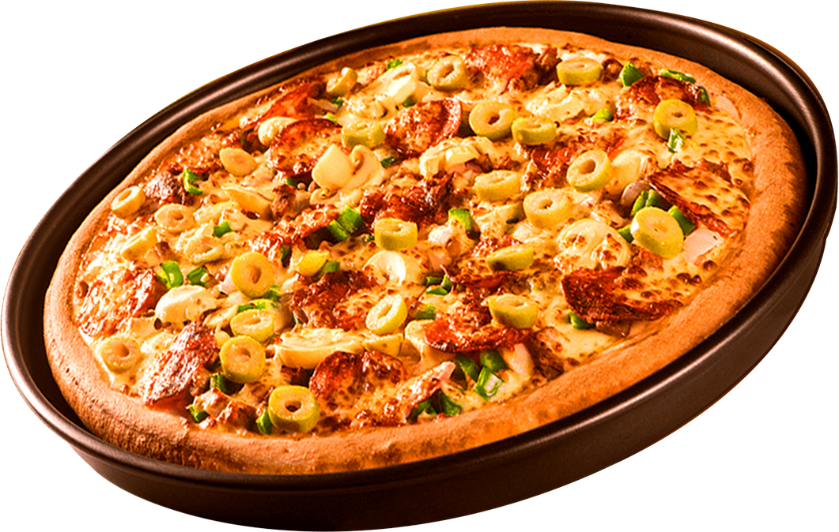
‘Slice of Success: PIZZA Sales Analysis’
95%
Positive Feedback
Presented by:
Subham Sinha
Tools Used: Power BI, SQL Server, Excel
2025

Slide 2
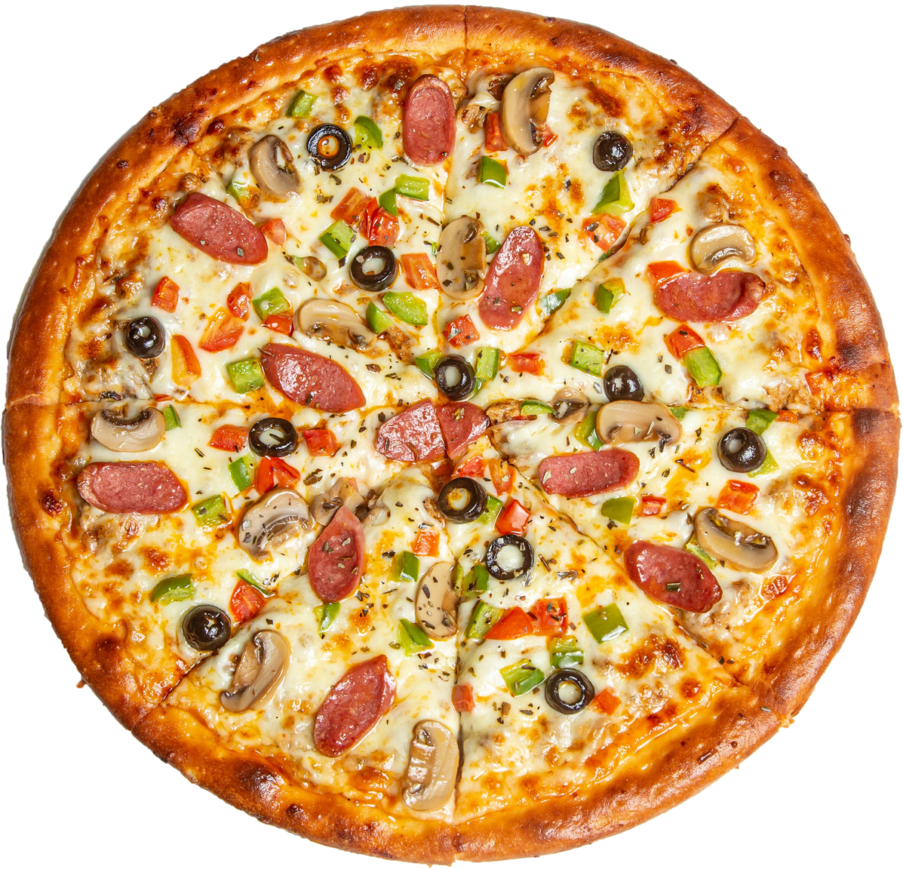
PROBLEM STATEMENT
KPI REQUIREMENTS (Key Performance Indicators)
We need to calculate the following metrics from pizza sales data:
Total Revenue ➤ The sum of the total price of all pizza orders.
Average Order Value ➤ The average amount spent per order. ➤ Formula: Total Revenue ÷ Total Number of Orders
Total Pizzas Sold ➤ The total quantity of all pizzas sold.
Total Orders ➤ The total number of orders placed.
Average Pizzas Per Order ➤ The average number of pizzas sold per order. ➤ Formula: Total Pizzas Sold ÷ Total Number of Orders
2025

Slide 3
PROBLEM STATEMENT
CHARTS REQUIREMENTS
We would like to visualize various aspects of pizza sales data to gain insights and understand key trends. We have identified the following requirements for creating charts:
1. Daily Trend for Total Orders:
Create a bar chart that will display trend of total orders over a specific time period. This chart will help us identify any patterns or fluctuations in order volumes on a daily basis.
2. Monthly Trend for Total Orders:
Create a line chart that illustrates the hourly trend of total orders throughput the day. This chart will allow us to identify peak hours or periods of high order activity.
Percentage of Sales by Pizza Category:
Create a pie chart that shows the distribution of sales across different pizza categories. This chart will provide insights into the popularity of various pizza categories and their contribution to overall sales.
2025

Slide 4
PROBLEM STATEMENT
CHARTS REQUIREMENTS
4. Percentage of sales by Pizza Size:
Generate a pie chart that represents the percentage of sales attributed to different pizza sizes, this chart will help us understand customer preference for pizza sizes and their impact on sales.
5. Total Pizzas Sold by Pizza category:
Create a funnel chart that presents the total number of pizzas sold for each pizza category. This chart will allow us to compare the sales performance of different pizza categories.
6. Top 5 best sellers by Total pizza sold:
Create a bar chart highlighting the top 5 best – selling prizes based on the total number of pizzas sold. This chart will help us identify the most popular pizza options.
7. Bottom 5 worst sellers by Total Pizzas Sold:
Create a bar chart showcasing the bottom 5 worst-selling pizzas based on the total numbers of pizzas sold. This chart will enable us to identify underperforming or less popular pizza options.
2025

Slide 5
PROBLEM STATEMENT
CHARTS REQUIREMENTS
6. Top 5 best sellers with respect to total quantity
7. Bottom 5 worst sellers by Total Pizzas Sold:
Create a bar chart showcasing the bottom 5 worst-selling pizzas based on the total number of pizzas sold. This chart will enable us to identify underperforming or less popular pizza options.
2025

Slide 6
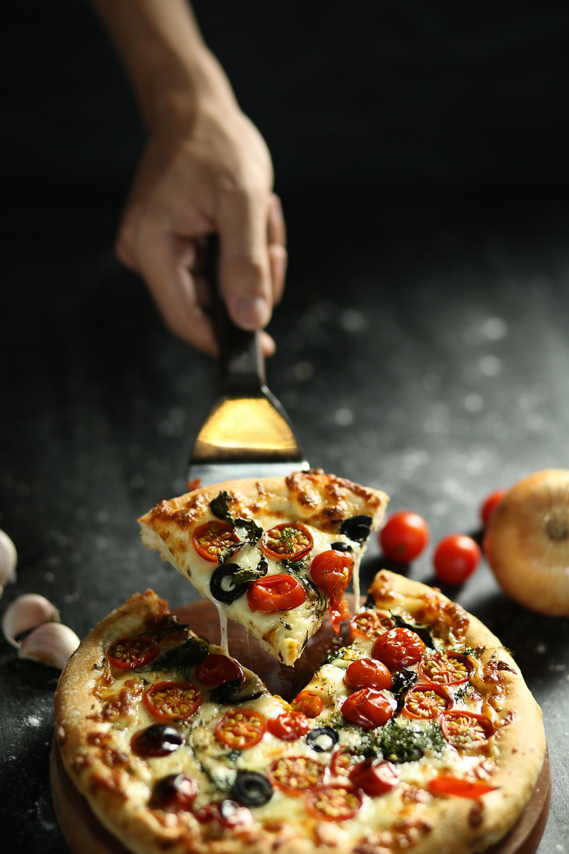
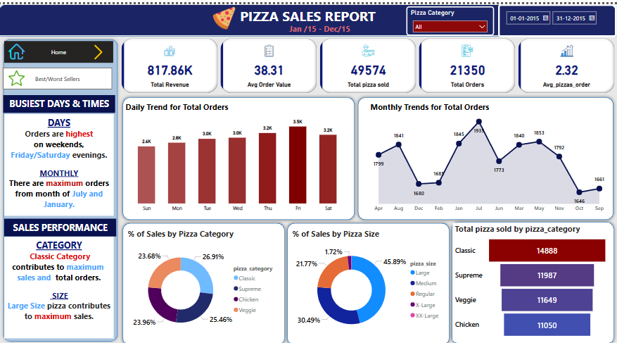
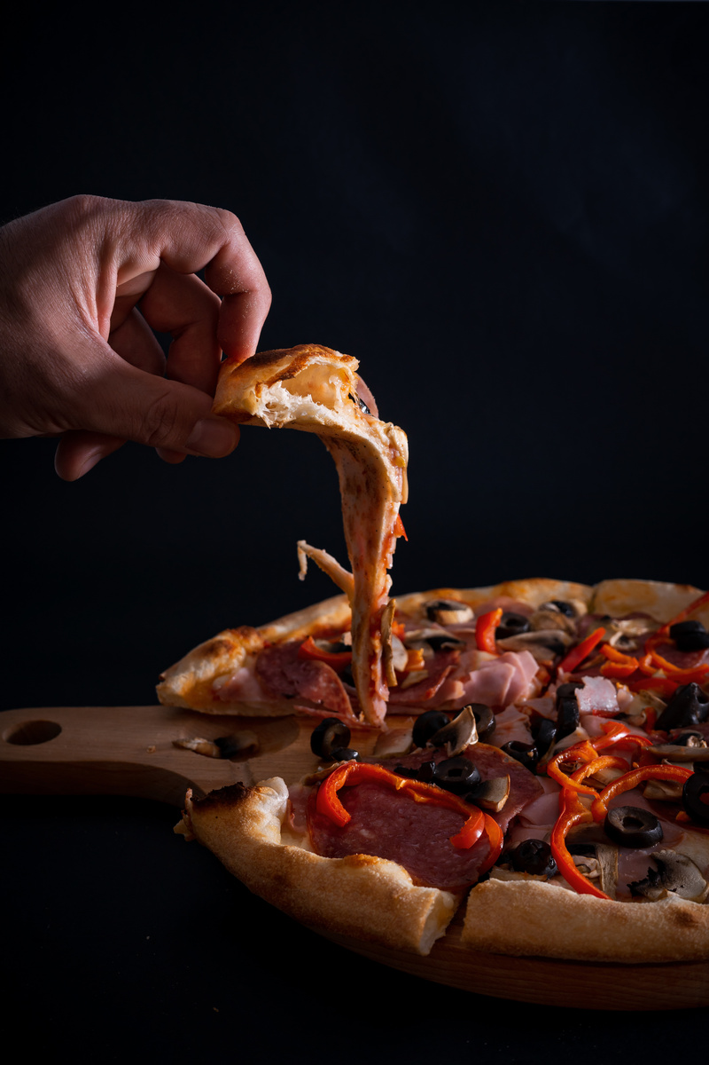


SUMMARY DASHBOARD PAGE
Len More

Slide 7
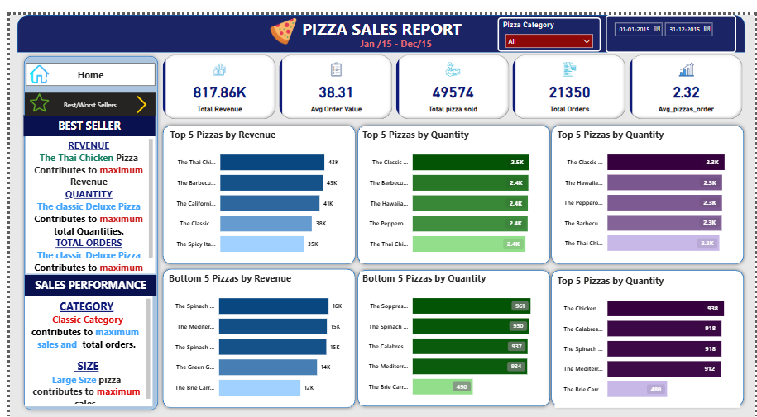
DETAIL DASHBOARD PAGE
Len More

Slide 8
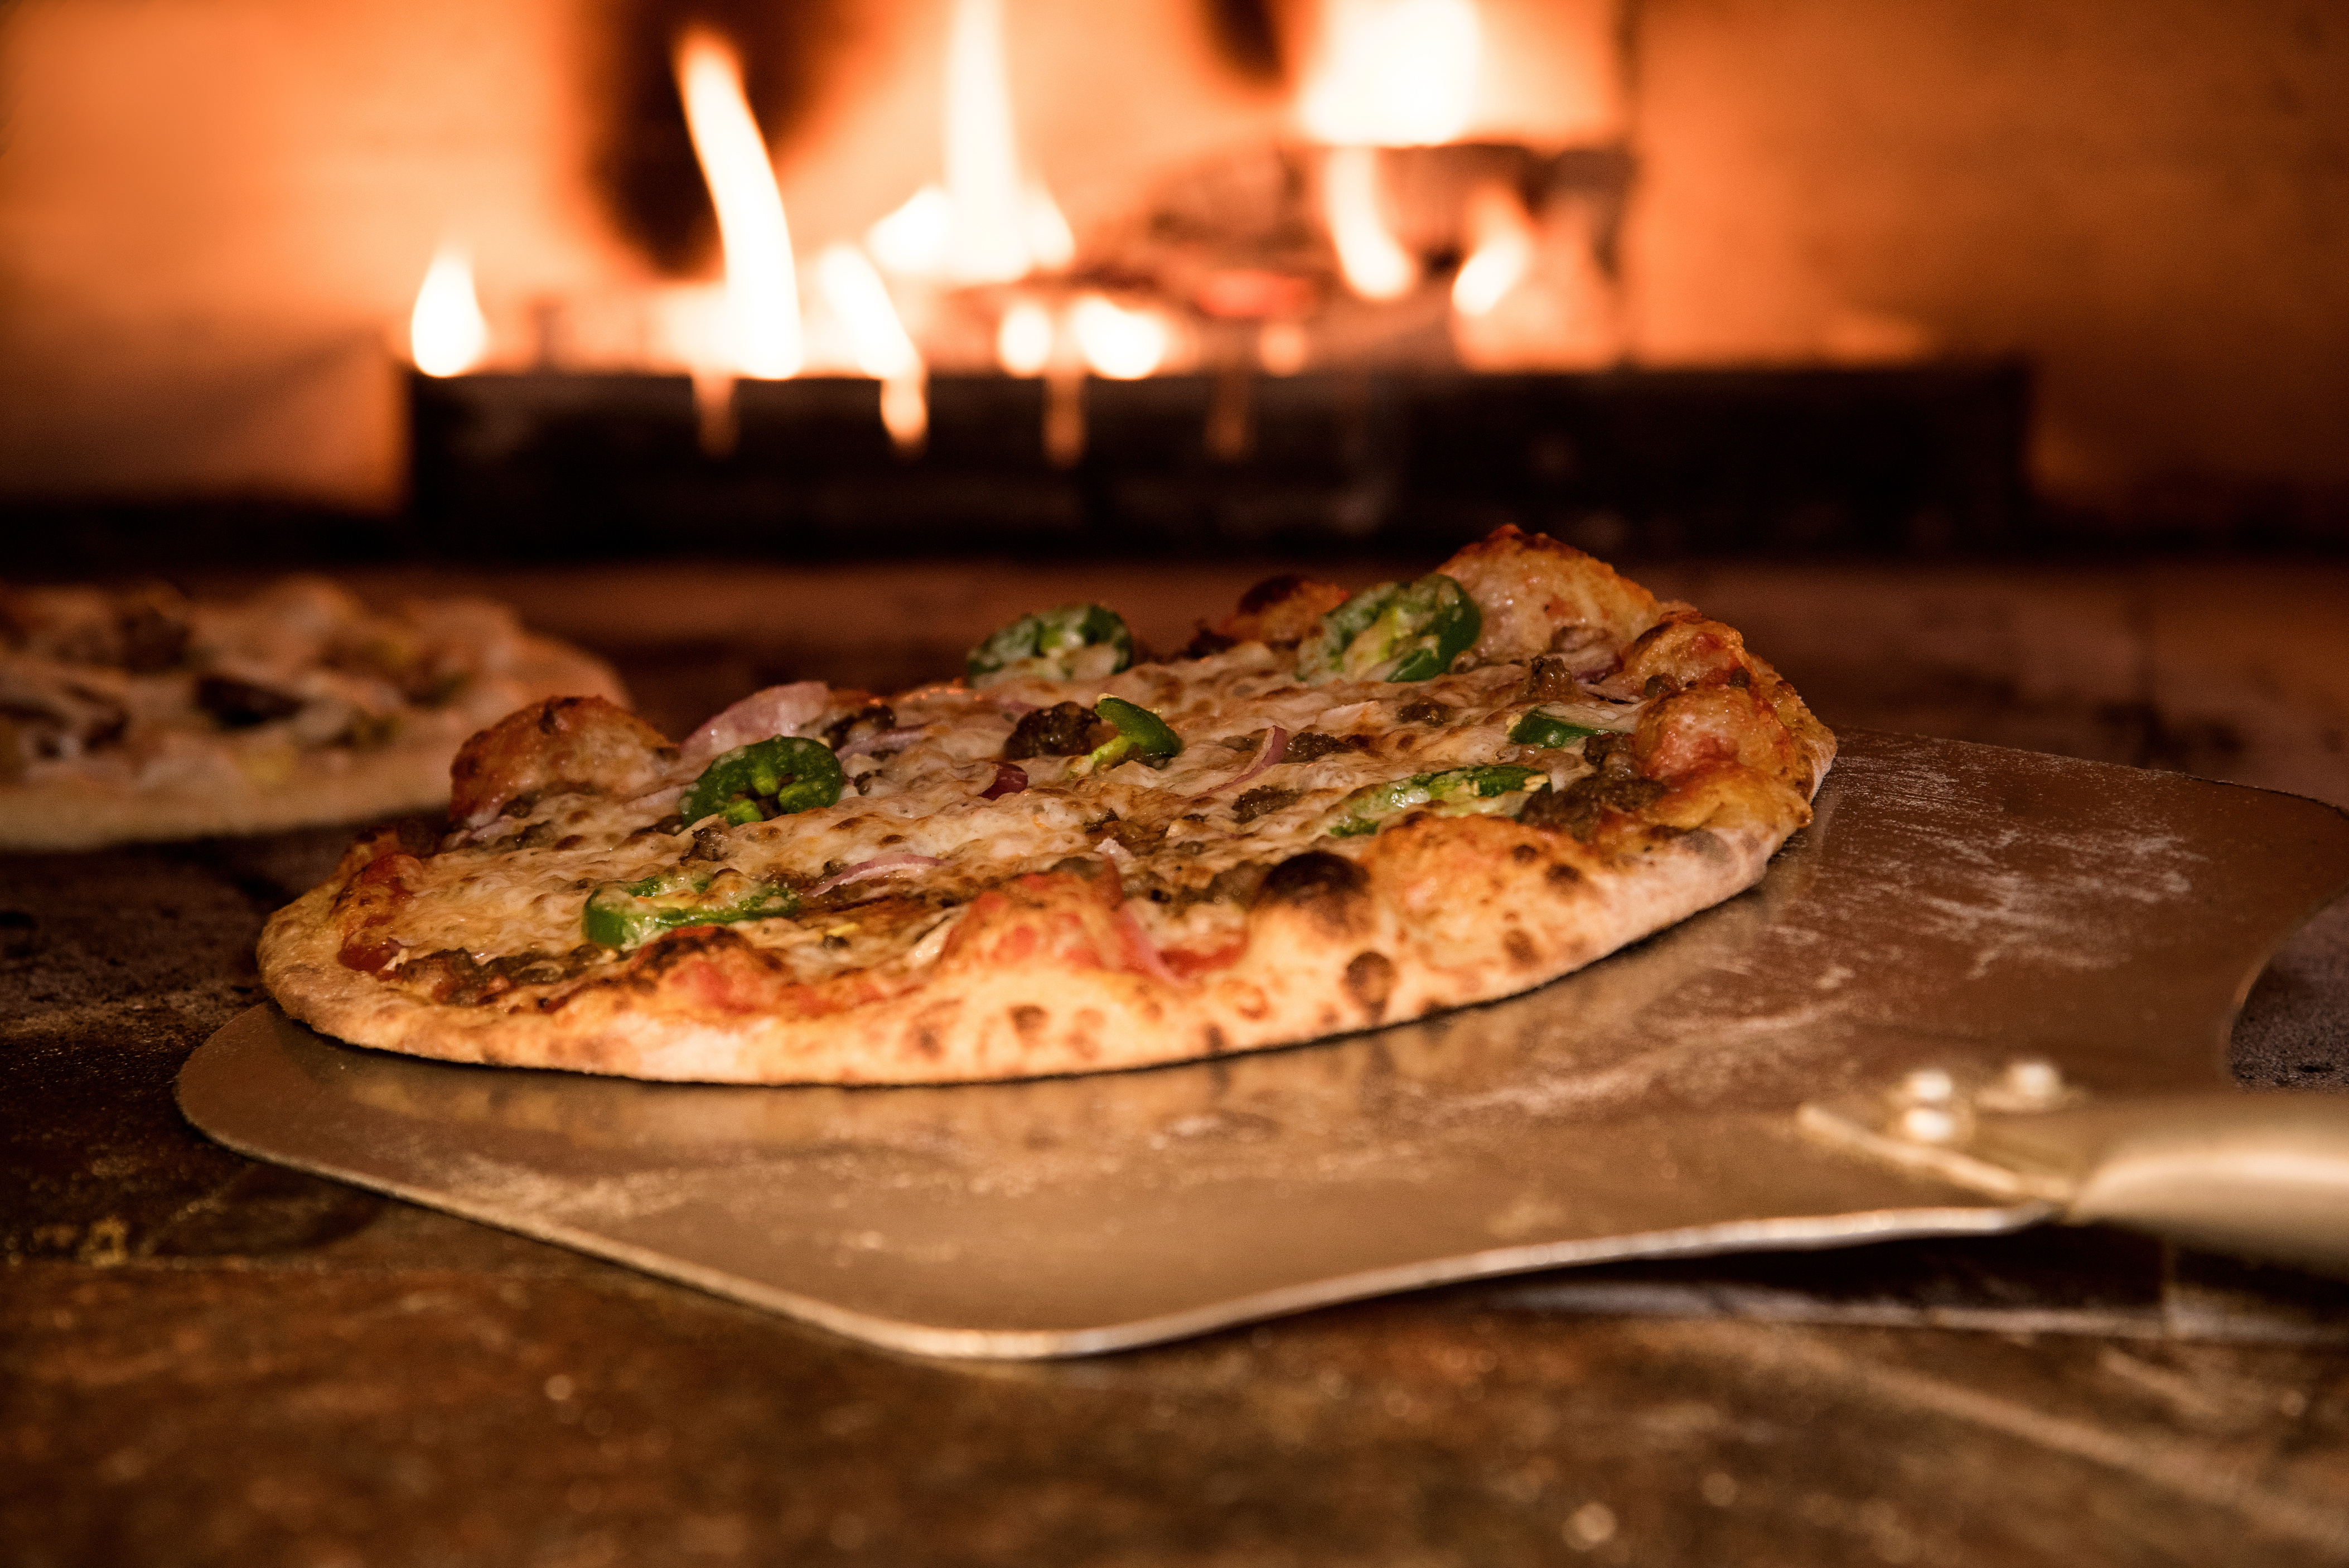
Top Performing Pizzas insights
Learn More
Thai Chicken Pizza leads in revenue contribution, while the Classic Deluxe Pizza tops the chart in quantity sold.
The Classic Category as a whole contributes the most to total sales, with the Large Size being the most preferred among customers.

Slide 9
Worst Performing Pizzas insights
Learn More
The Brie Carre Pizza consistently ranks at the bottom, generating the lowest revenue and recording the least quantity sold, making it the least popular item on the menu.

Slide 10




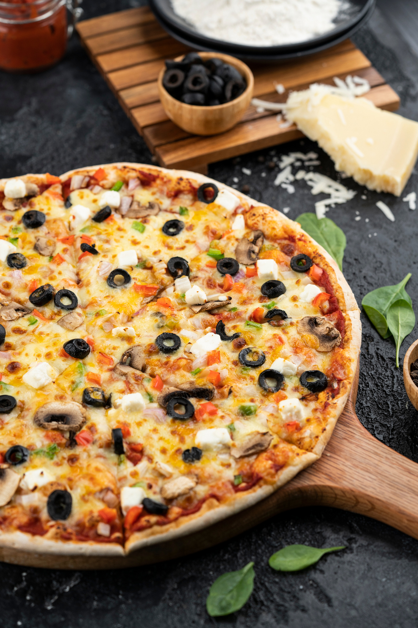
THANK YOU
SUBHAM SINHA
2025

